Slide 1
Surfaces in neuroimaging

Slide 2
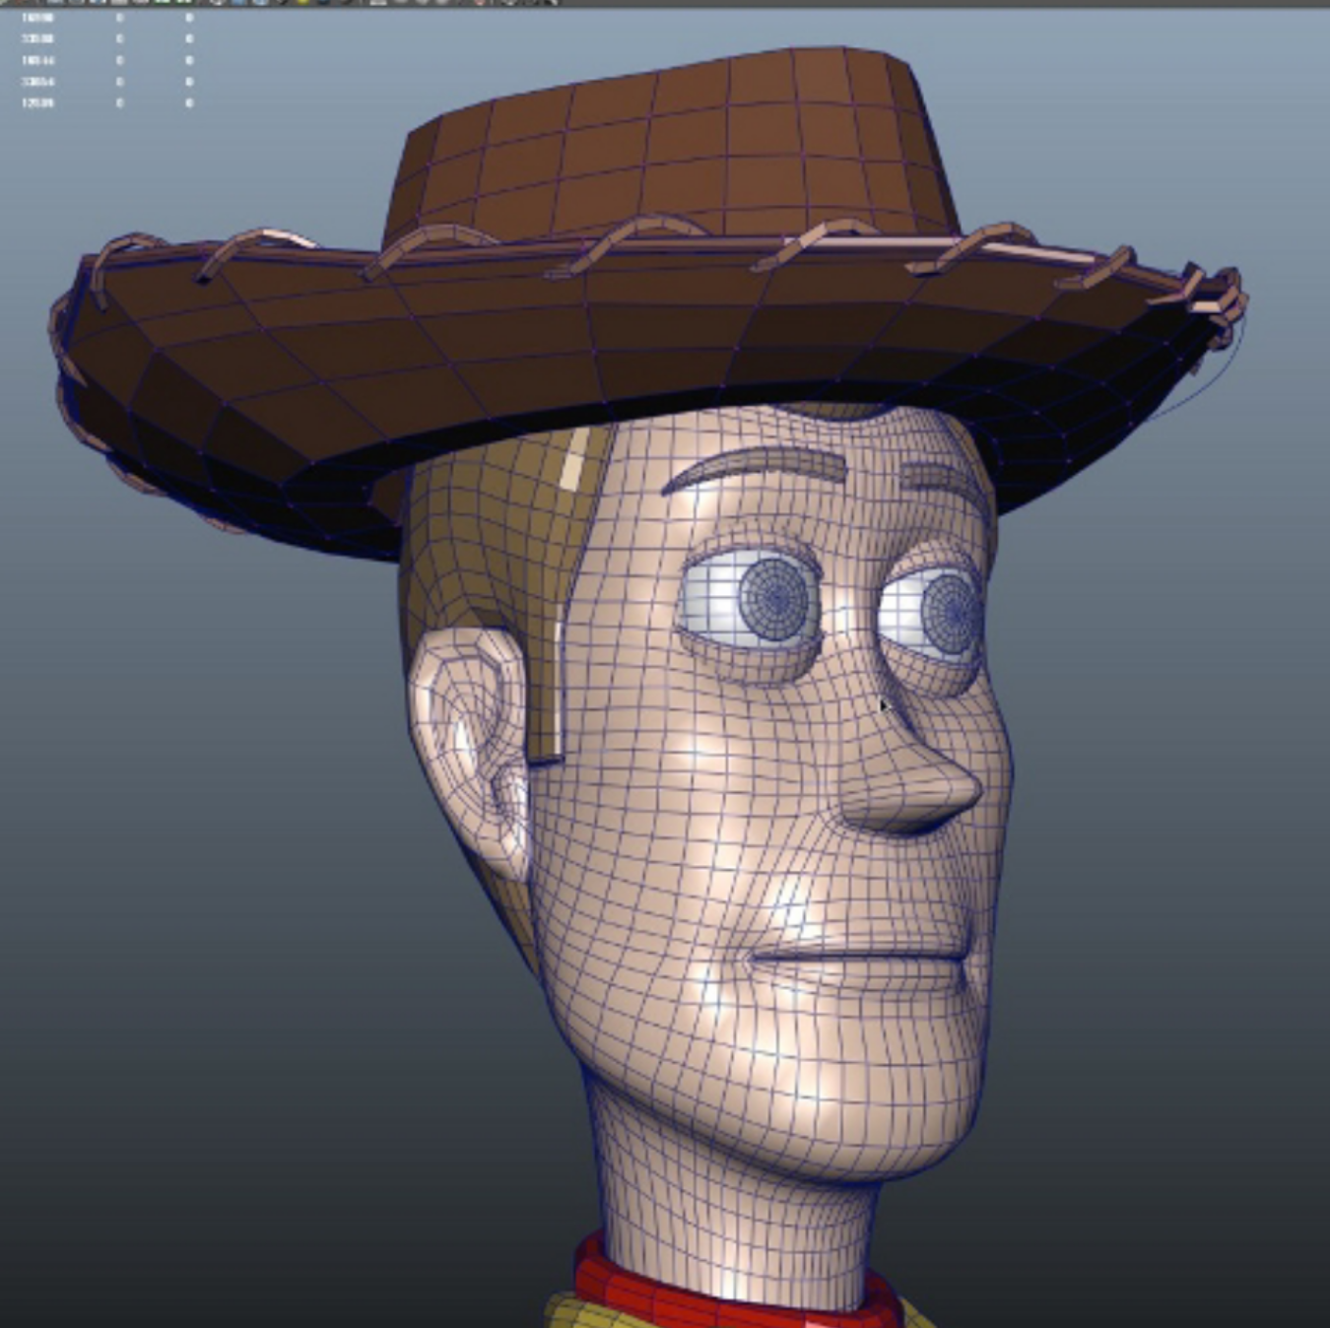
Surfaces: what are they?
A surface is a special case of a graph (aka network)
It has nodes and edges
The structure of nodes and edges follow strict rules:
A triangular mesh requires edges be part of 3-cliques
A rectangular mesh requires edges be part of 4-cliques
Video games and animated movies use meshes and 3d rendering
https://graphics.pixar.com/library/SigAsia2015/paper.pdf

Slide 3
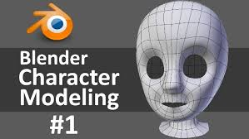
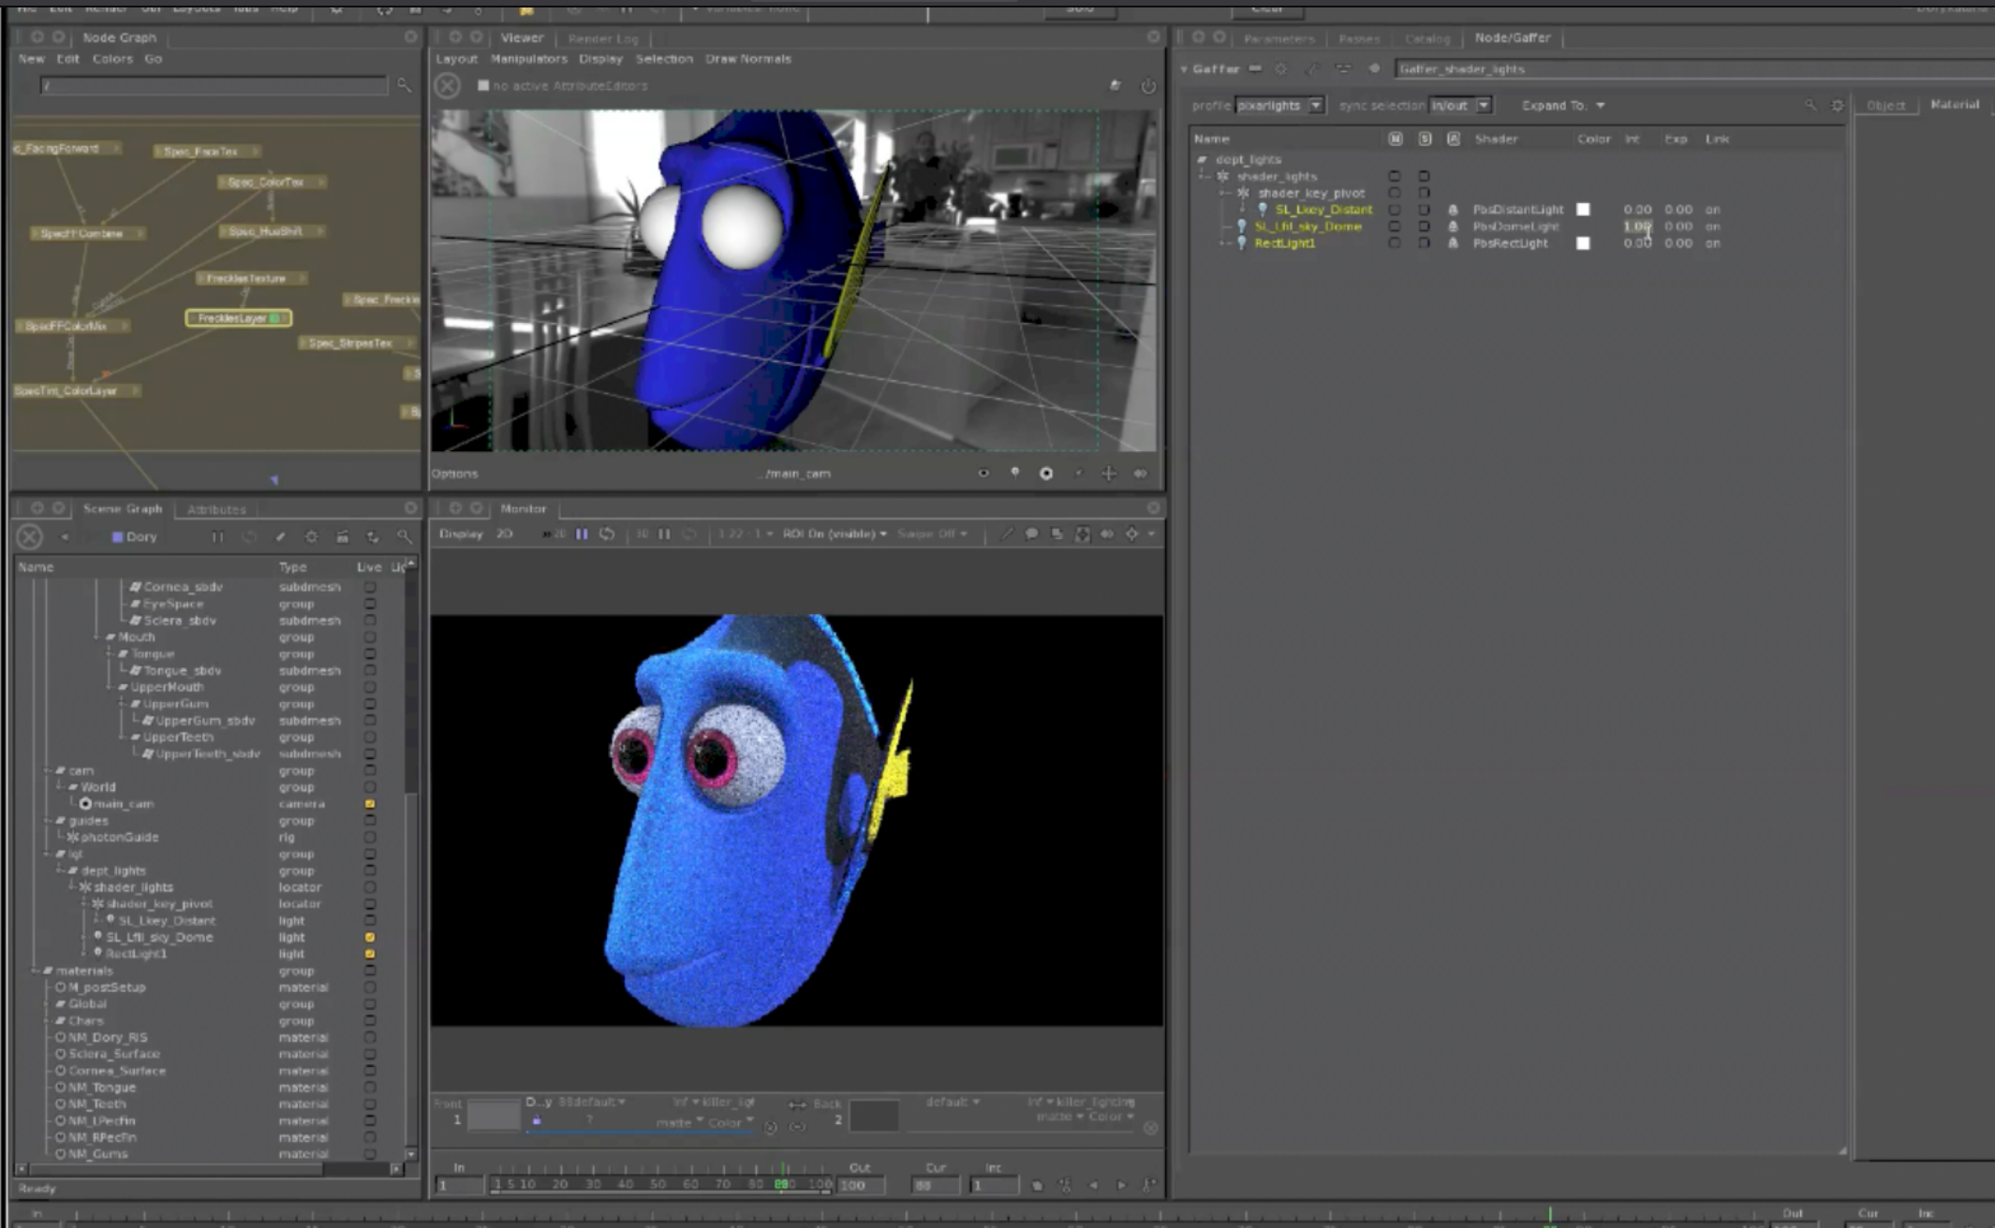
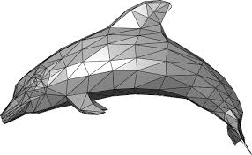
Surfaces can be designed by artists

Slide 4
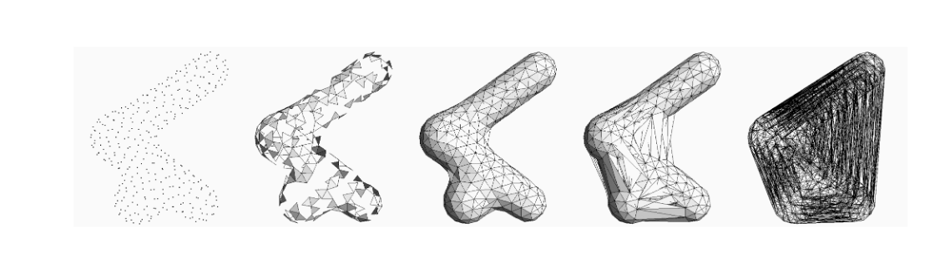
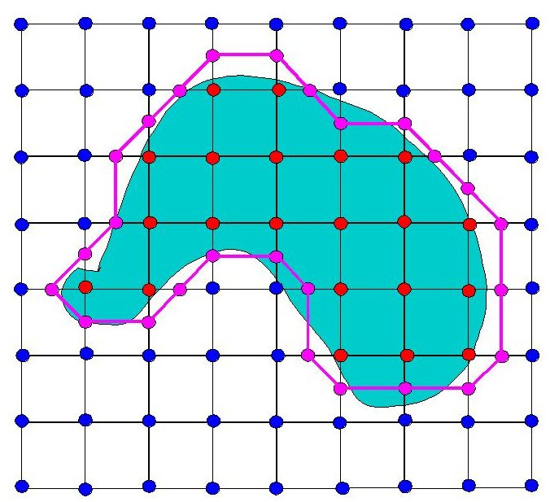
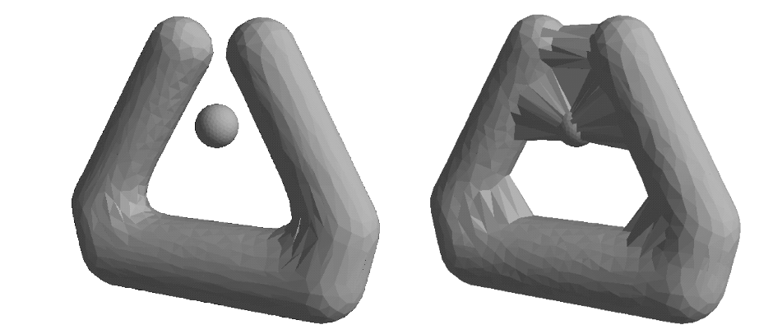
They can also be built by segmenting voxels

Slide 5
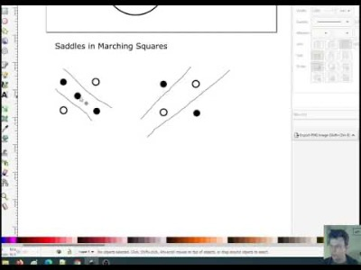

Slide 6
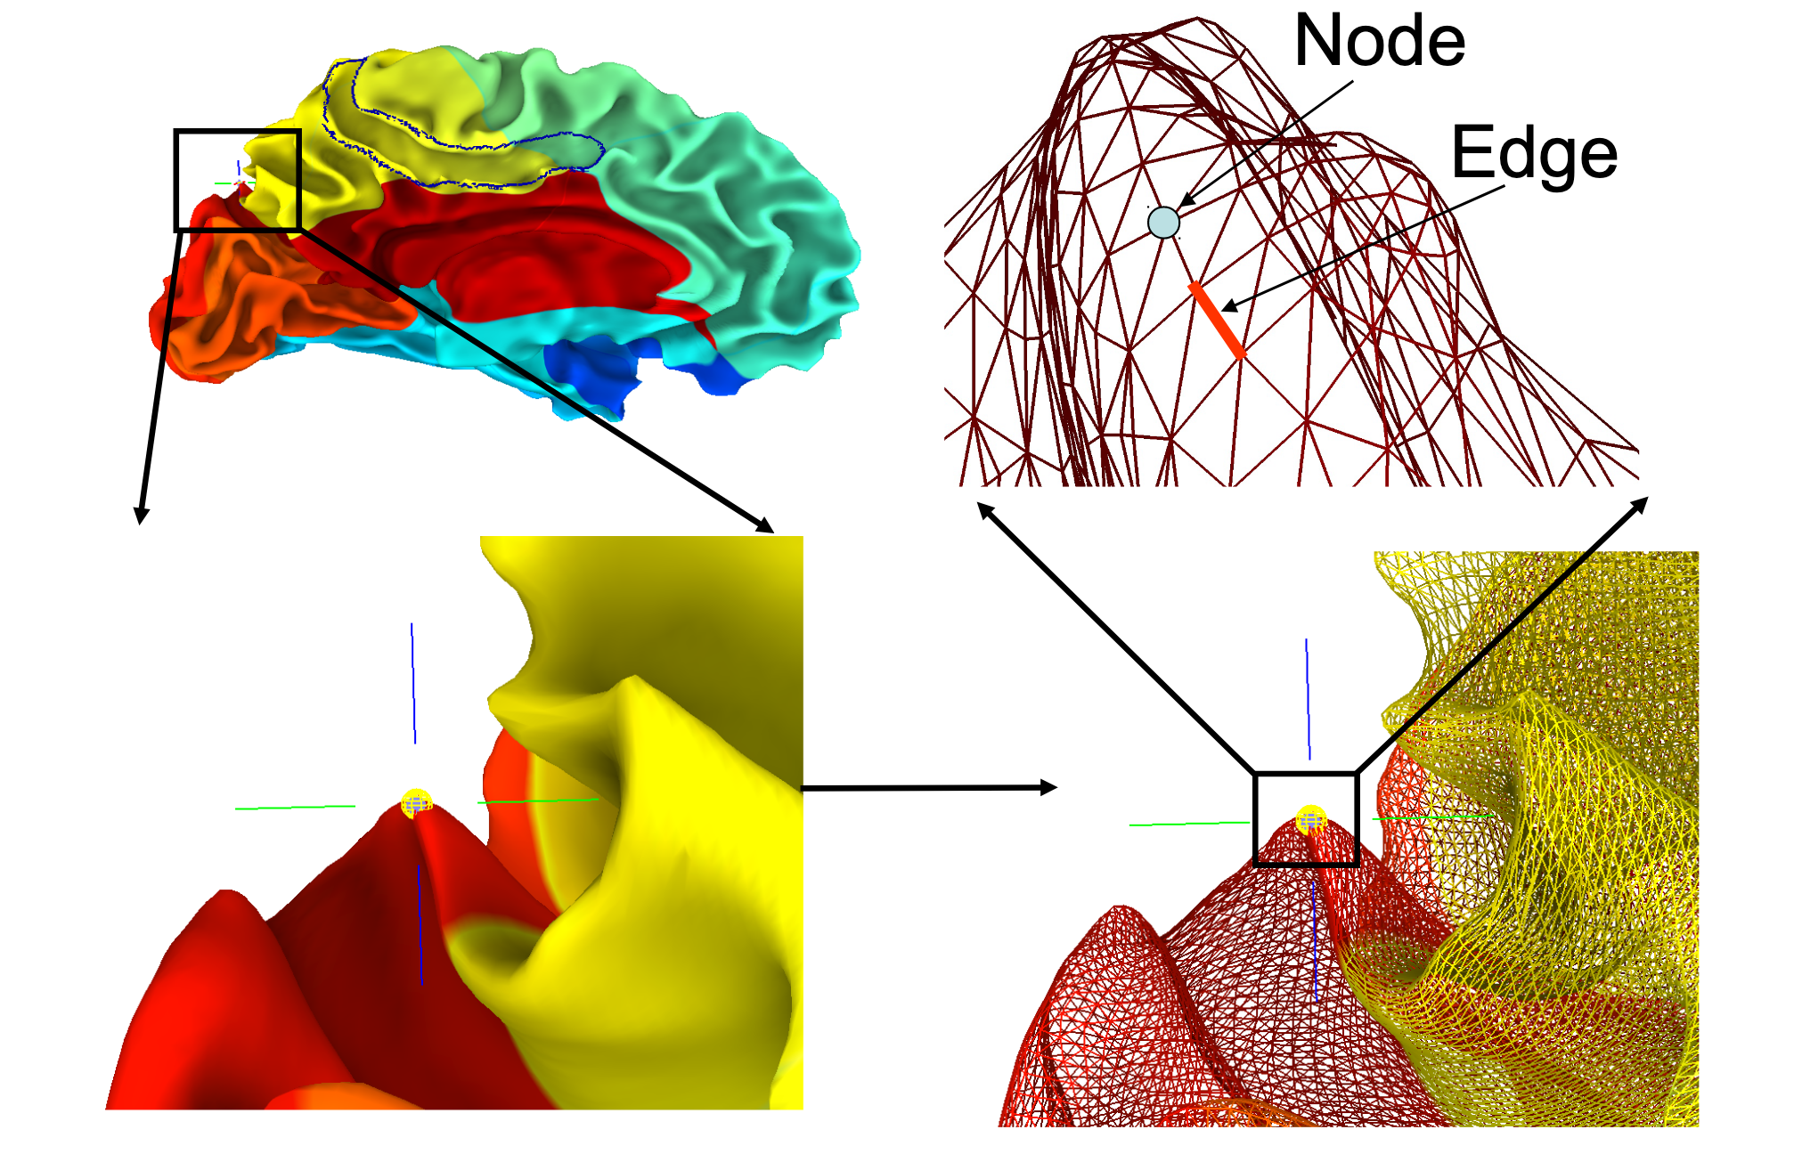
How are they used for neuroscience?

Slide 7
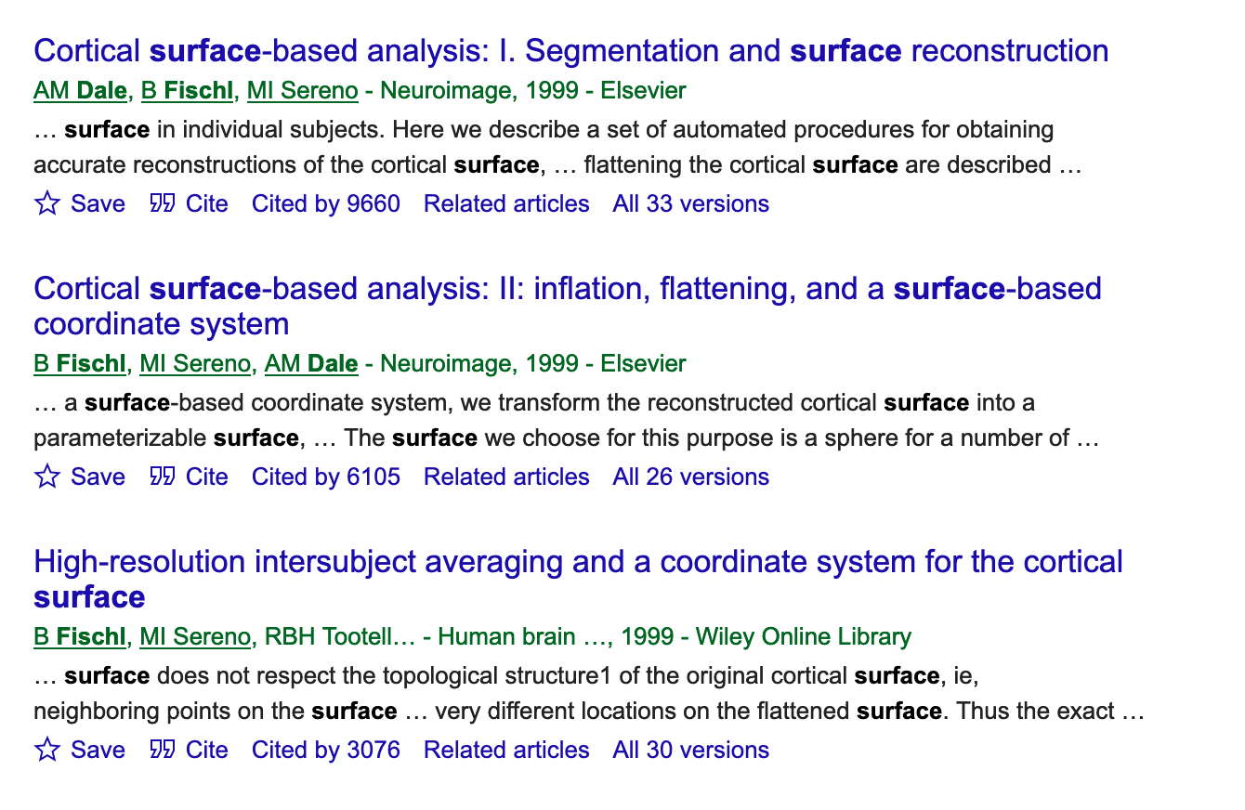

Slide 8

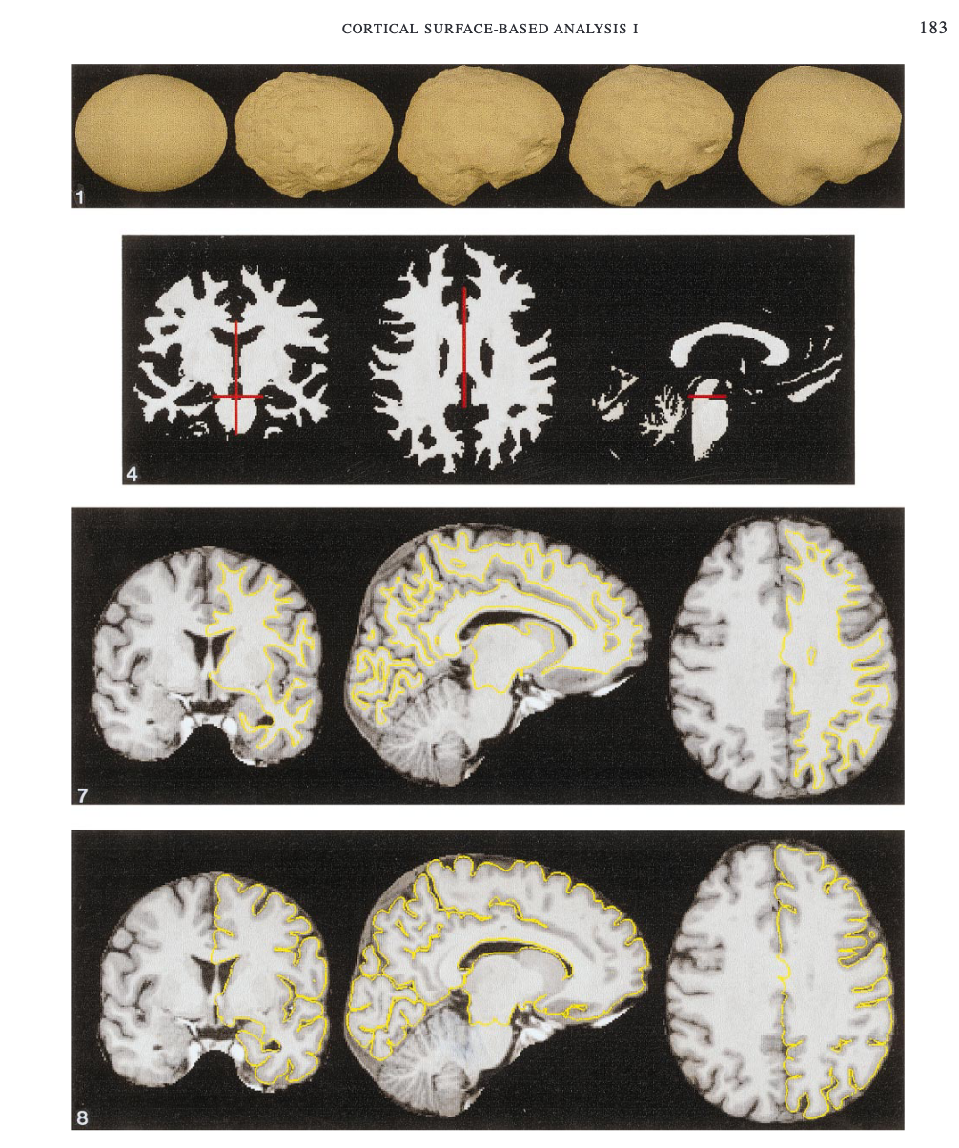
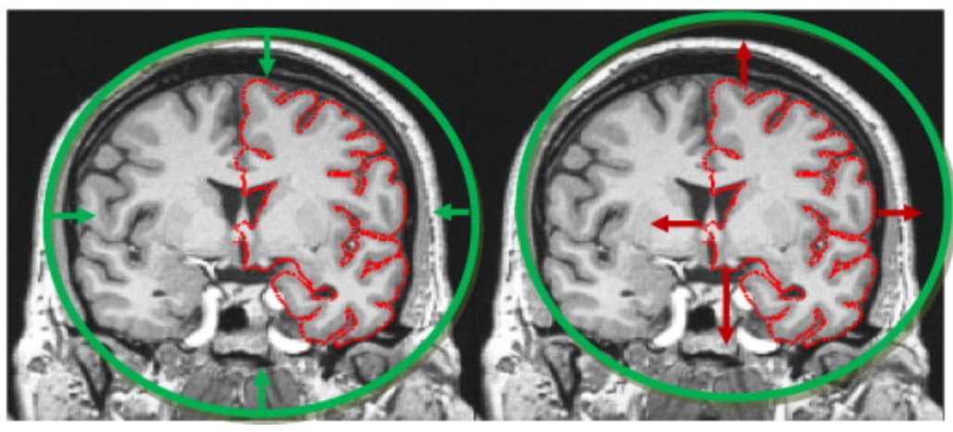
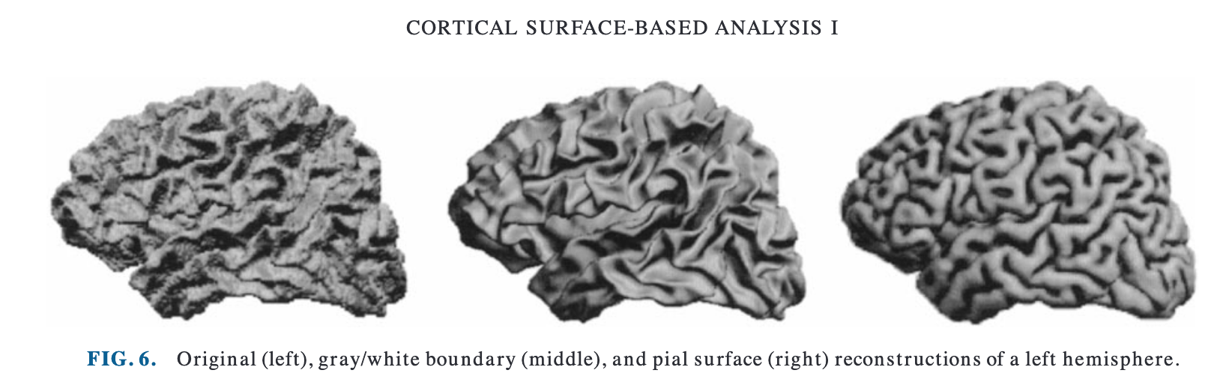

Slide 9
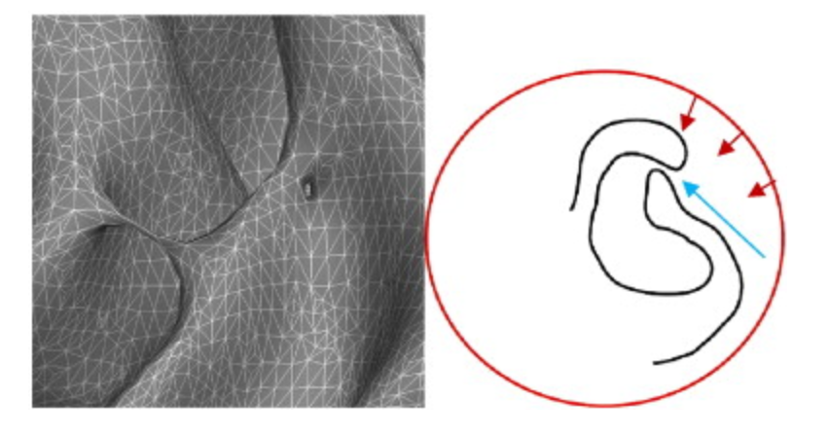
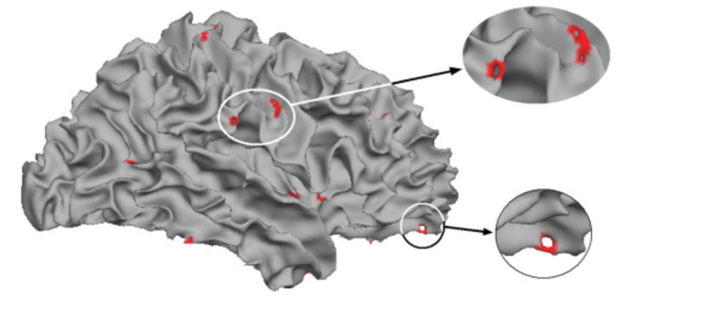
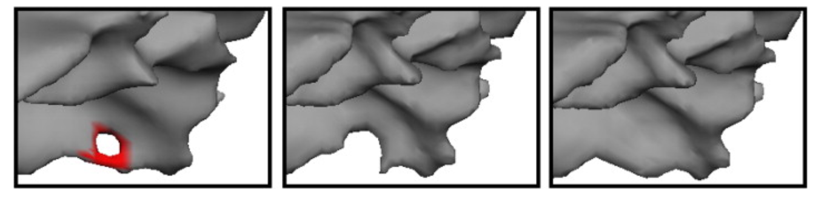
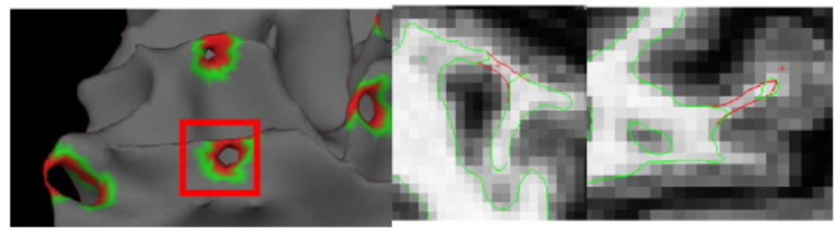
Fix issues with the surfaces

Slide 10
Fundamentals: file format
0.06 0.85 0.03
0.60 0.23 0.87
0.76 0.16 0.28
0.46 0.85 0.23
0.54 0.30 0.11
0.25 0.35 0.06
0.09 0.46 0.72
0.71 0.70 0.31
0.35 0.28 0.47
0.97 0.47 0.26
…
…
1 2 3
1 2 4
1 3 5
Coordinates in space
Index is implicit
”Index”, or vertex ID
Each Index has a coordinate in space
Triangles are 3-tuples of indices
Try it yourself! mris_convert rh.pial to rh.pial.asc
Triangles!

Slide 11
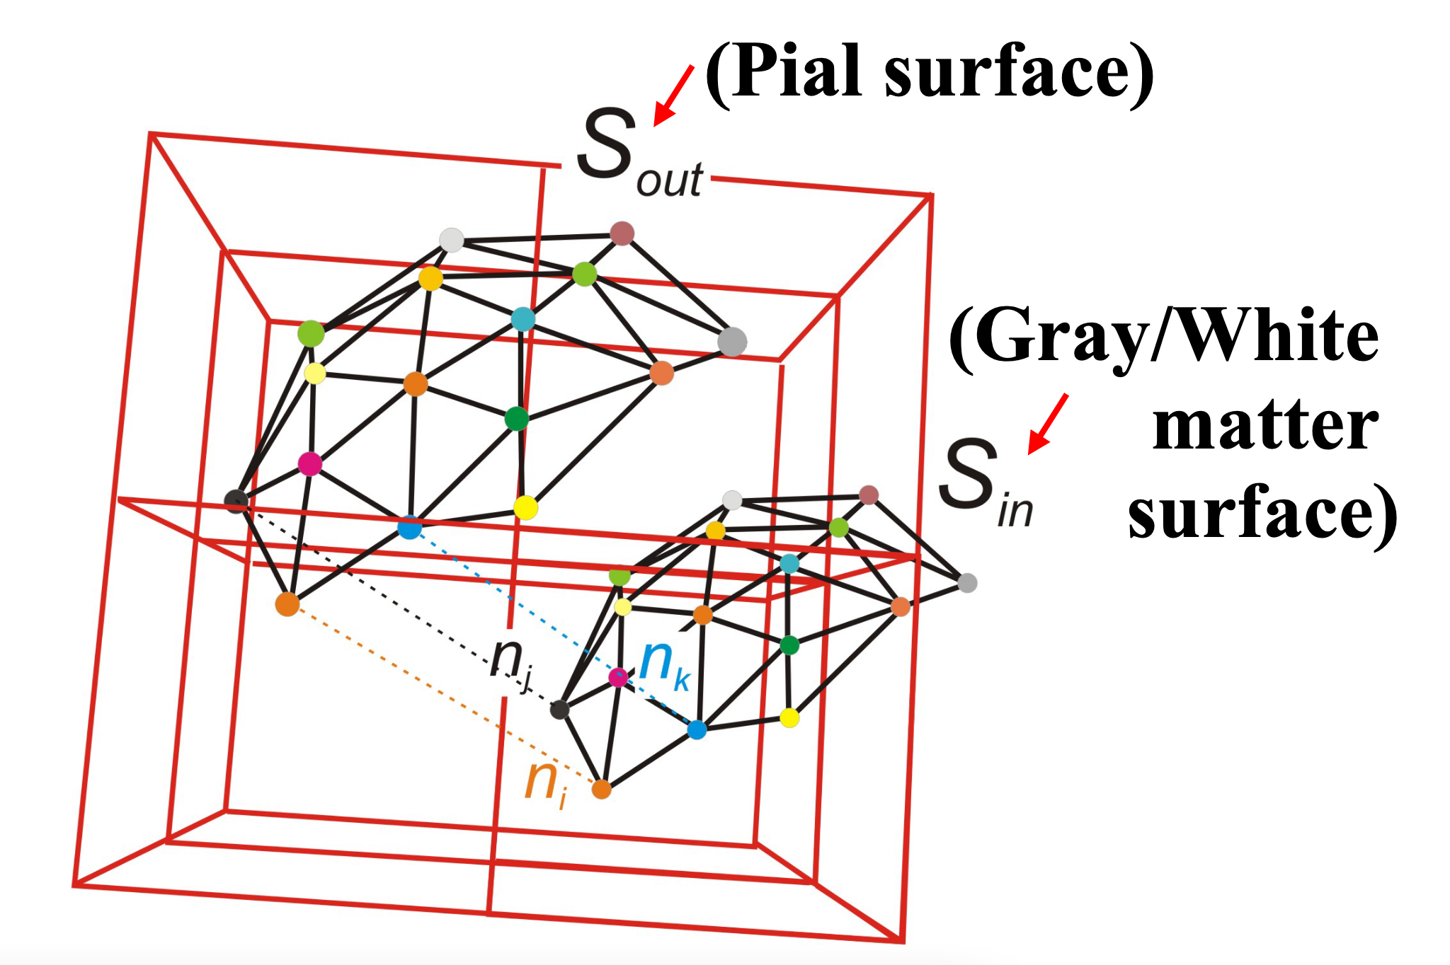
Mapping between volume and surface
Triangle
subvoxel spatial coordinate
(Red) Voxel boundaries
Index

Slide 12
We can map lots of things to vertices
Curvature of the surface (scalar)
Thickness of the surface (scalar)
Optical flow (vector)
BOLD time series (time series)
Region labels (scalar)
Once mapped to a vertex, you can do whatever you want to the spatial coordinates

Slide 13
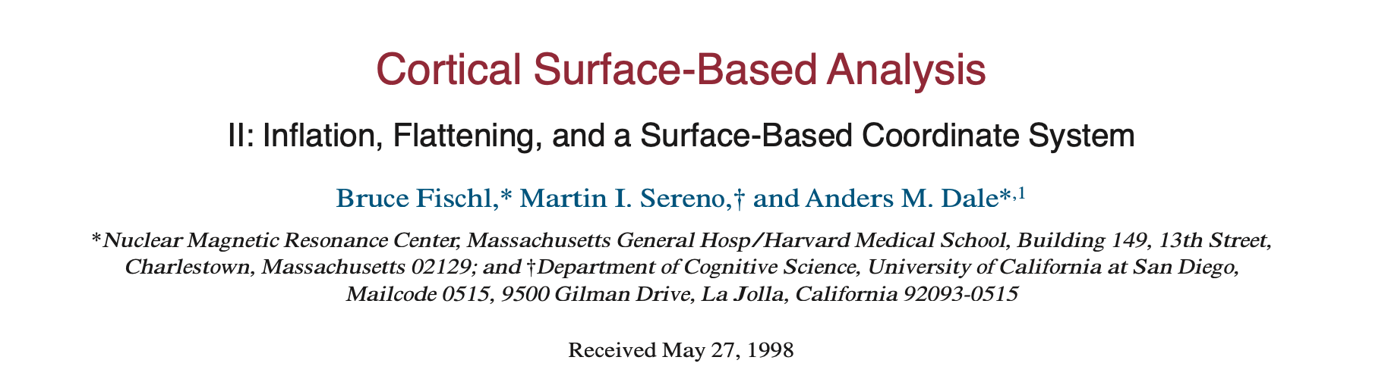
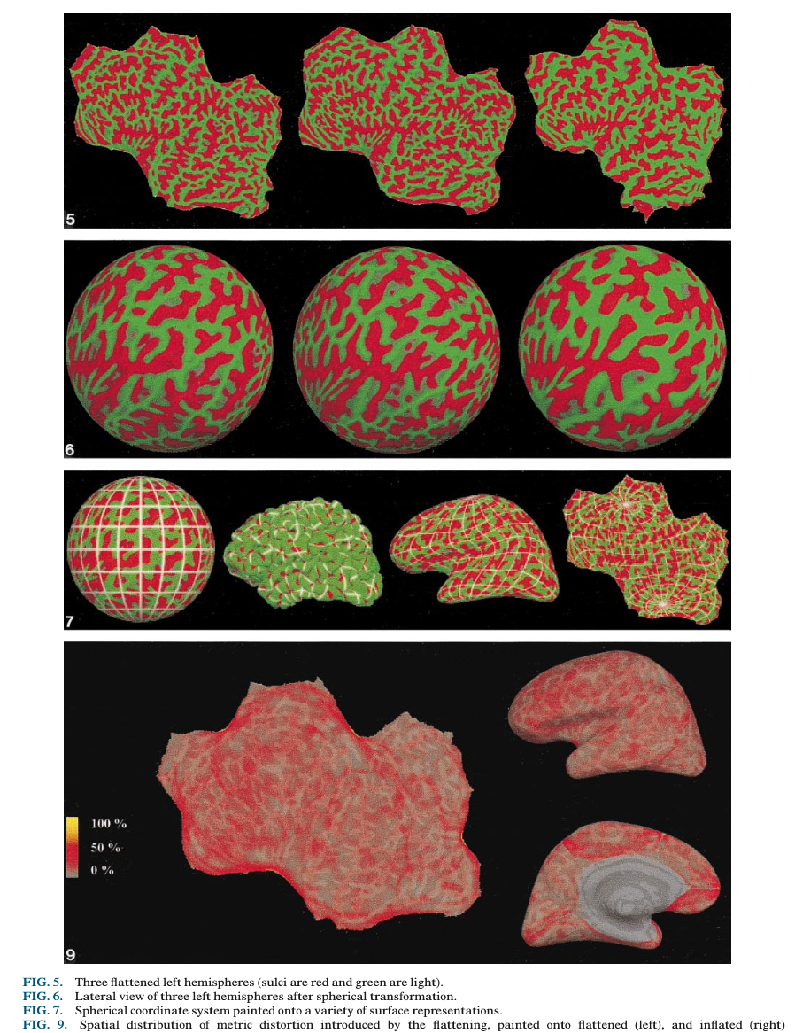
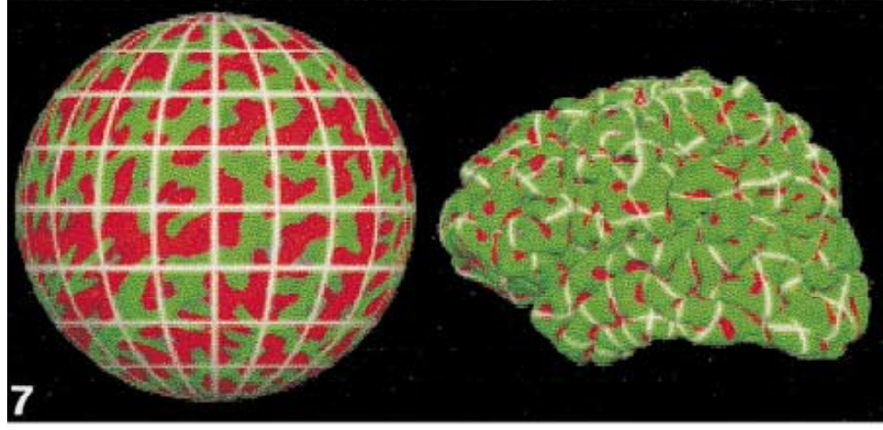
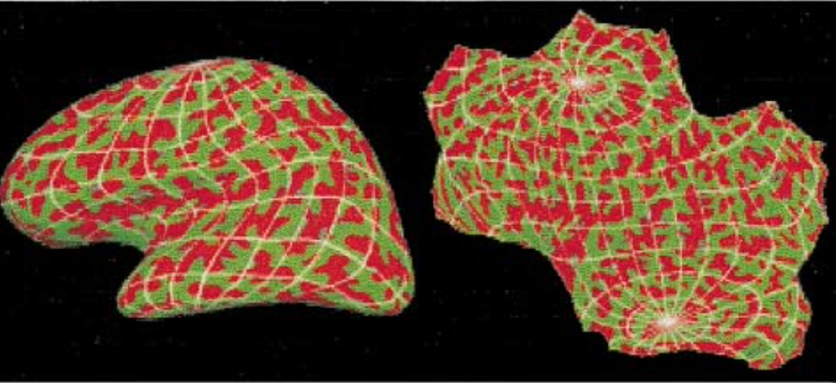

Slide 14
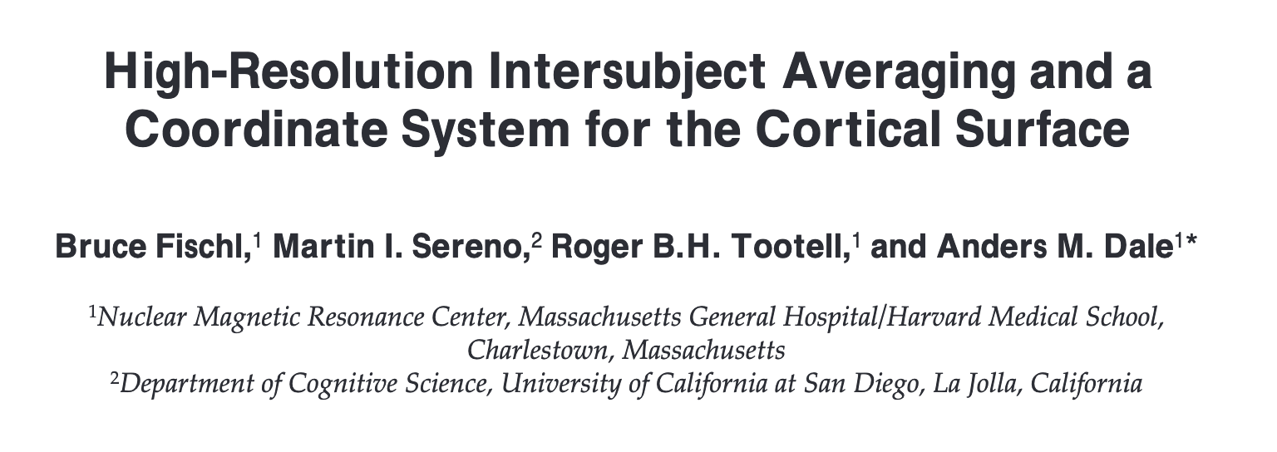
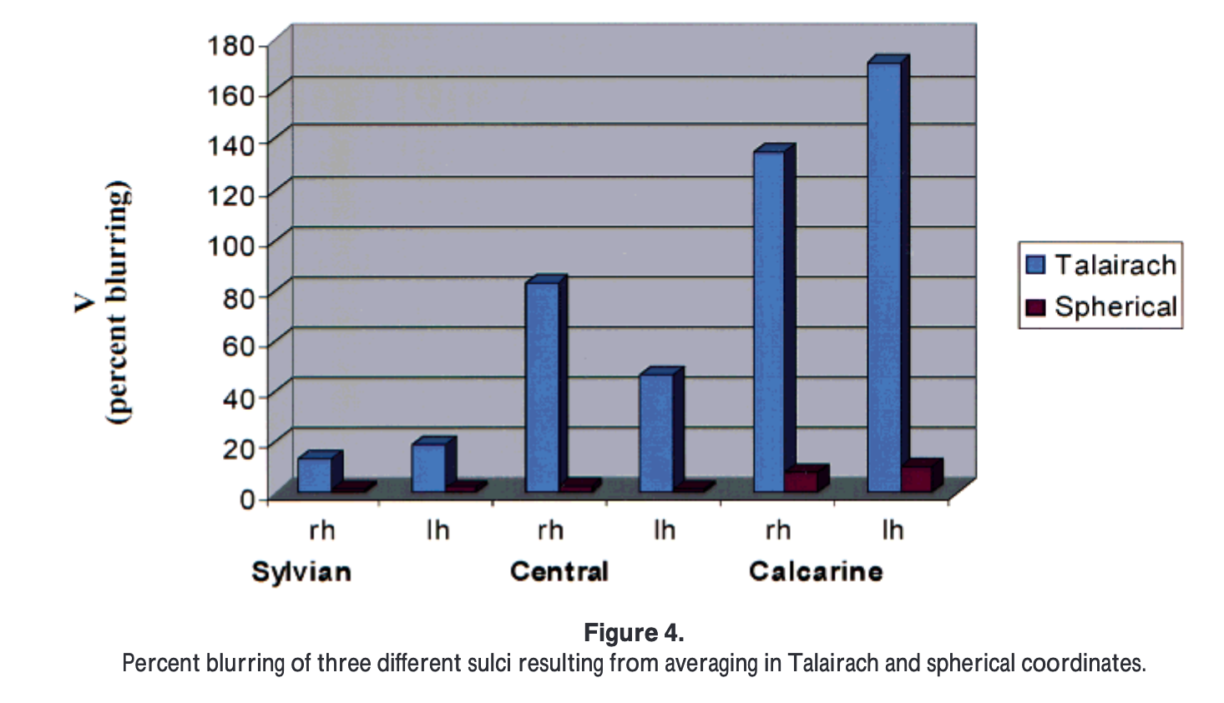
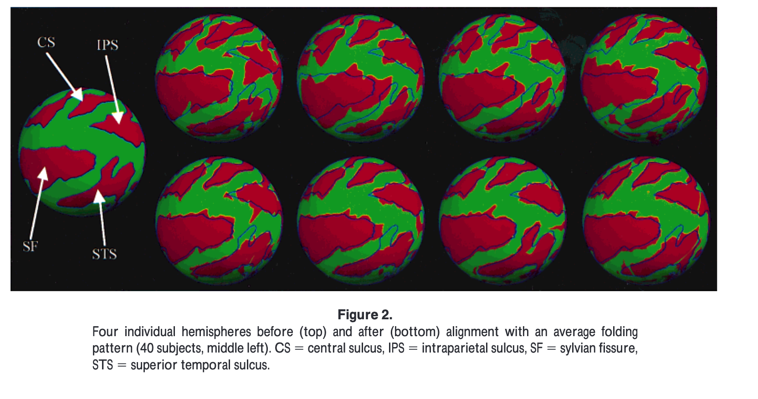
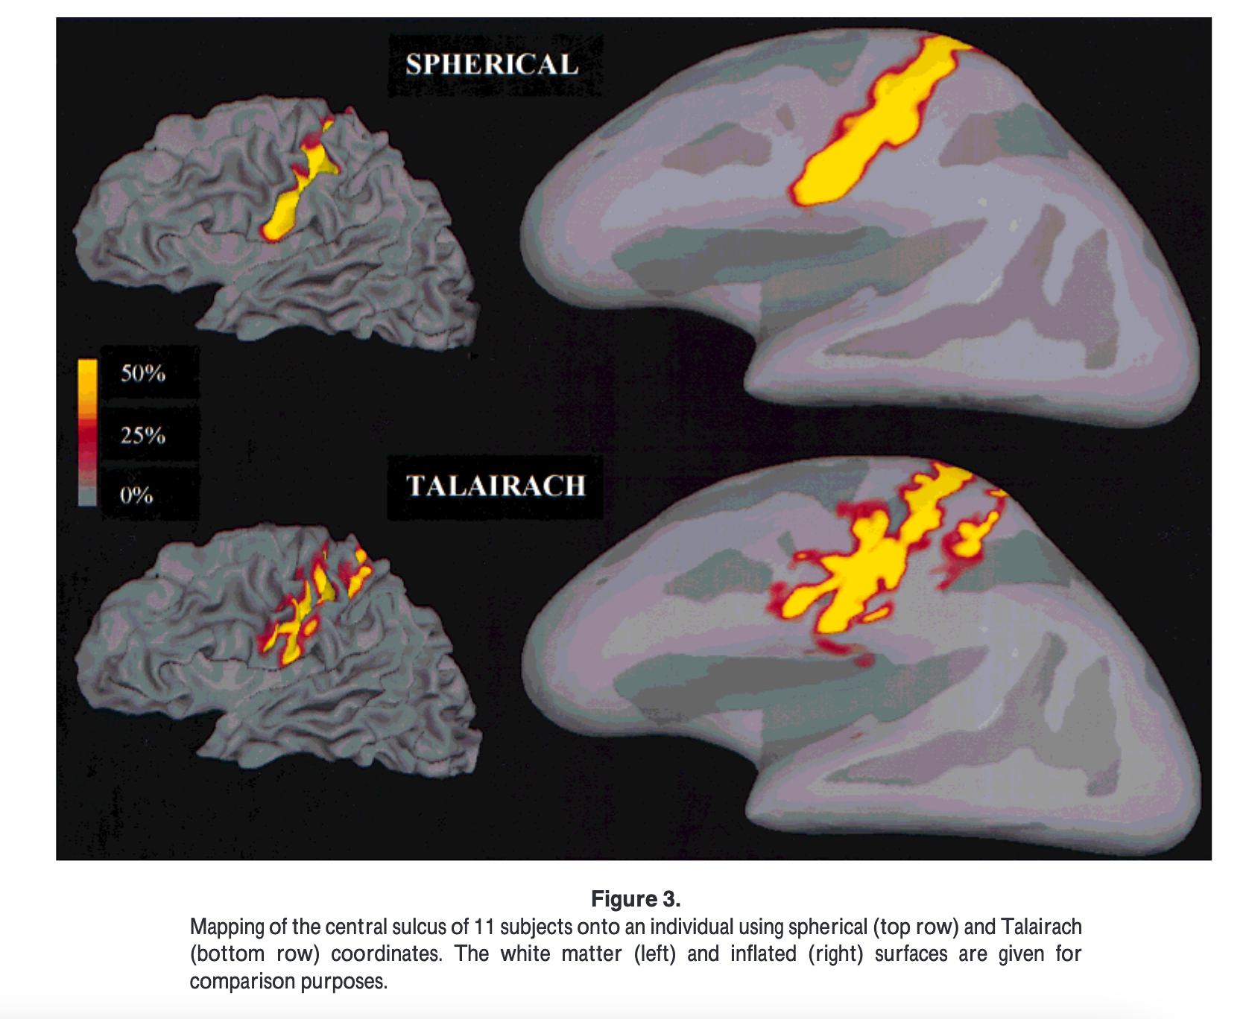
LOL

Slide 15
Registering to a template is great
But individuals still have different numbers of vertices!
AND they’re ordered differently!
Introducing: the standard surface

Slide 16
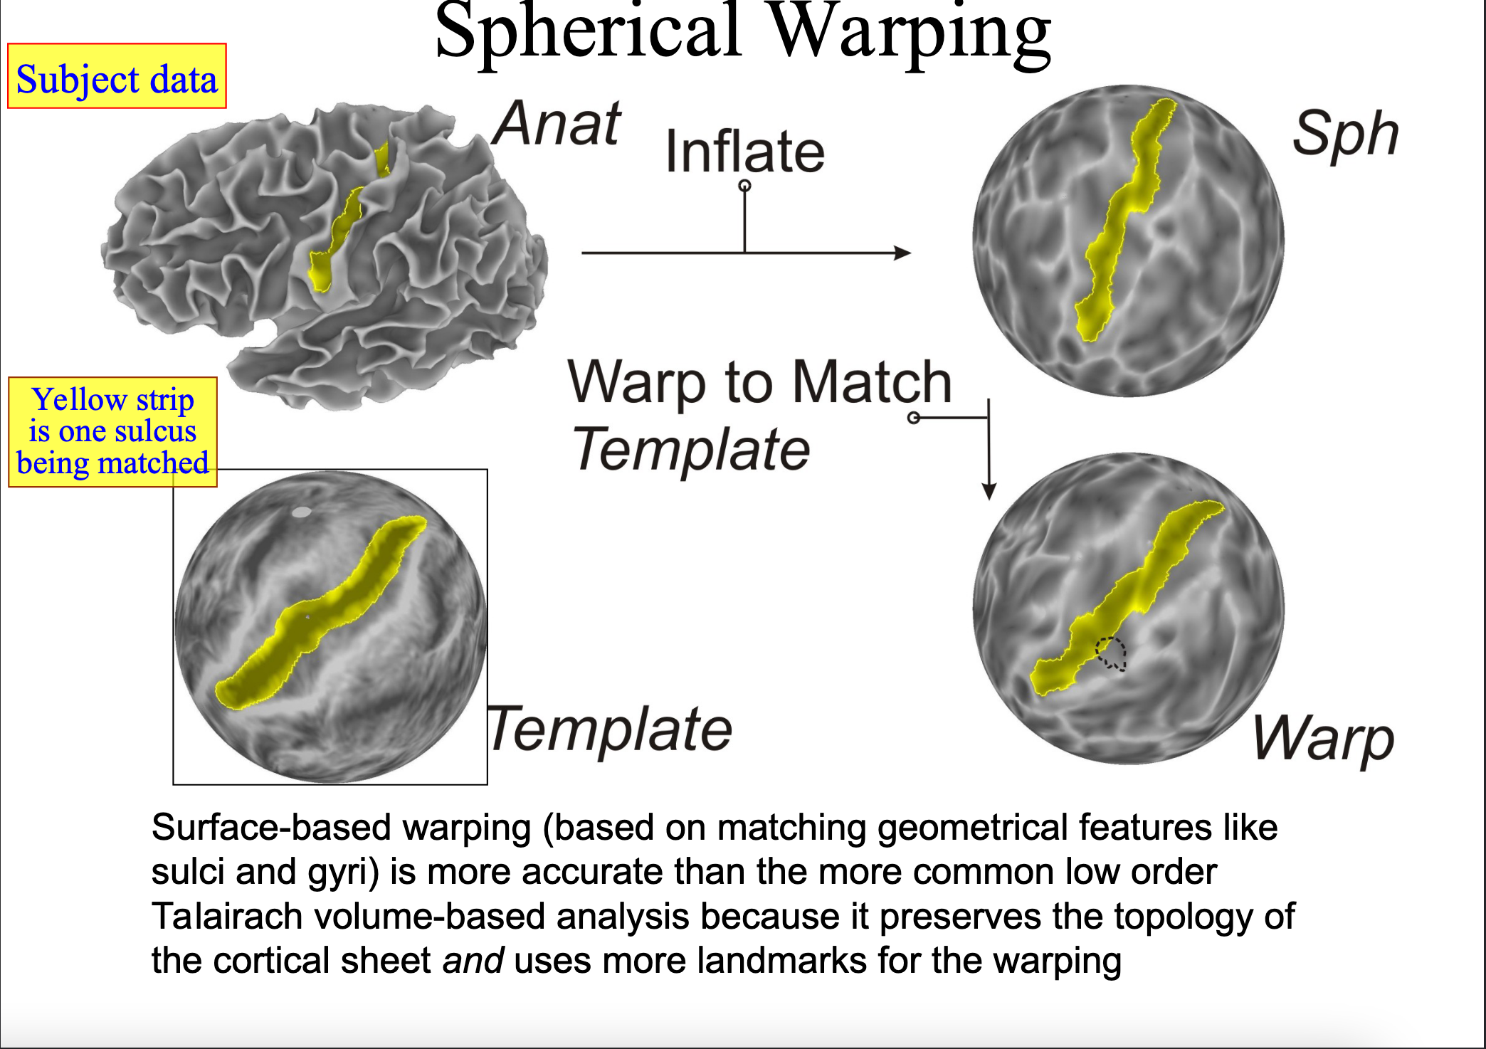
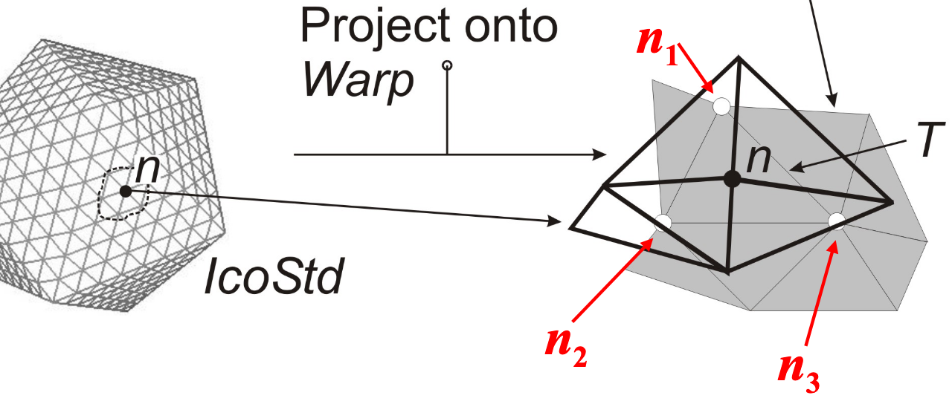

Slide 17
Subsequent developments
Freesurfer binary formats are annoying to work with
GIfTI files were created as a “NIfTI for surfaces”
Also turned out to be annoying: can only contain one surface
CIfTI files were invented to include 2 surfaces and some subcortical voxels
They were an ad-hoc fork of the NIfTI-2 image format
Only really supported by connectome_workbench
Opaque and difficult development/standards

